Slide 1
ECE 4250 - Digital and Image Processing
Super Resolution Imaging
Stefano Barbier (sab388), Raymond Xu (ryx2), Hugo Milan (hm496)

Slide 2
What is super resolution imaging?
Increase image resolution (size)
Combination of multiple images improves the image quality of this increased size image: this will be referred to as the “superimage”
Images from different positions and angles have different random noise
Images are filtered, aligned, expanded, interpolated, and finally, combined (added and averaged). The order of these operations can be modified slightly.
Optical hardware limitations are overcome - optical diffraction limit.
Reduces noise
Notes:
Diffraction limit = wavelength/(2*numerical aperture)

Slide 3
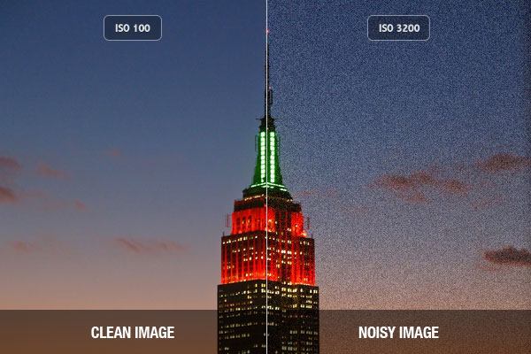
Image Noise
Unwanted variation in pixel brightness or color variation
High occurrence in low light photography or at high range
Aperture, shutter speed vs. ISO
ISO is sensitivity of the camera to light
Higher ISO causes increase in noise, but might be needed if scene is dark
Notes:
Low light photos exposed to fewer photons and so variations in photons hitting pixels is more evident
Sensor exposed to environmental conditions (heat) lead to spurious signals, made worse by amplification in circuitry
https://www.adorama.com/alc/0012955/article/FAQ-What-is-Noise-in-a-Digital-Photograph

Slide 4
Methods of Noise Reduction
Classical image filters
Super resolution imaging
Mean
Median
Midpoint
Adaptive
Single-image super resolution
Multi-image super resolution
Notes:
http://citeseerx.ist.psu.edu/viewdoc/download?doi=10.1.1.683.6783&rep=rep1&type=pdf

Slide 5
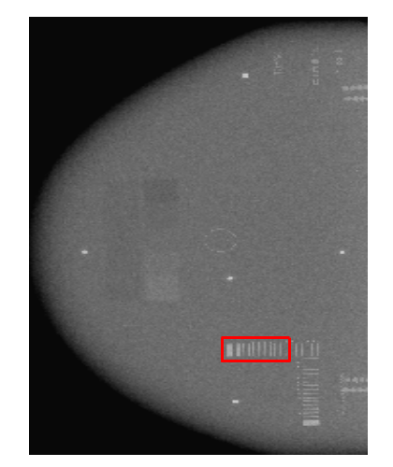
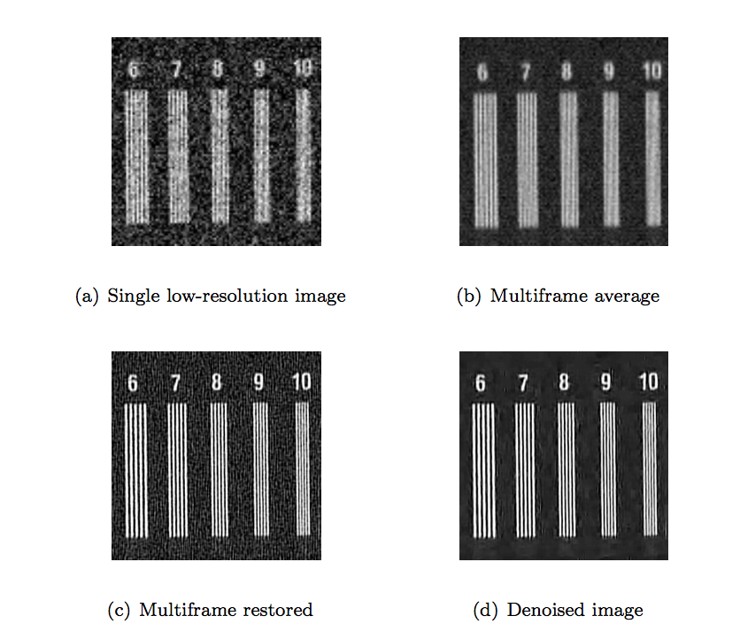
Applications of Super Resolution Imaging
Optical or diffractive
Microscopy
Geometrical or image-processing
Multiple image noise reduction (what we have done)
Satellite imaging
X-ray mammogram
Single image deblurring can be used on any image
Notes:
https://pdfs.semanticscholar.org/159a/5a01f3b78b22f59c7ff3c89c986d2de59475.pdf

Slide 6
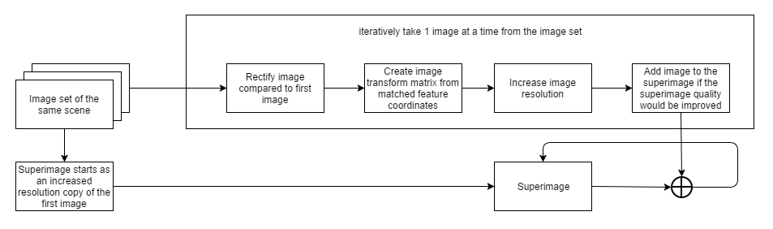
Implementation
Take multiple images of the same scene.
Align the images.
Create super resolution image through interpolation of these images.
Evaluate change in SNR between original images and super resolution image.

Slide 7
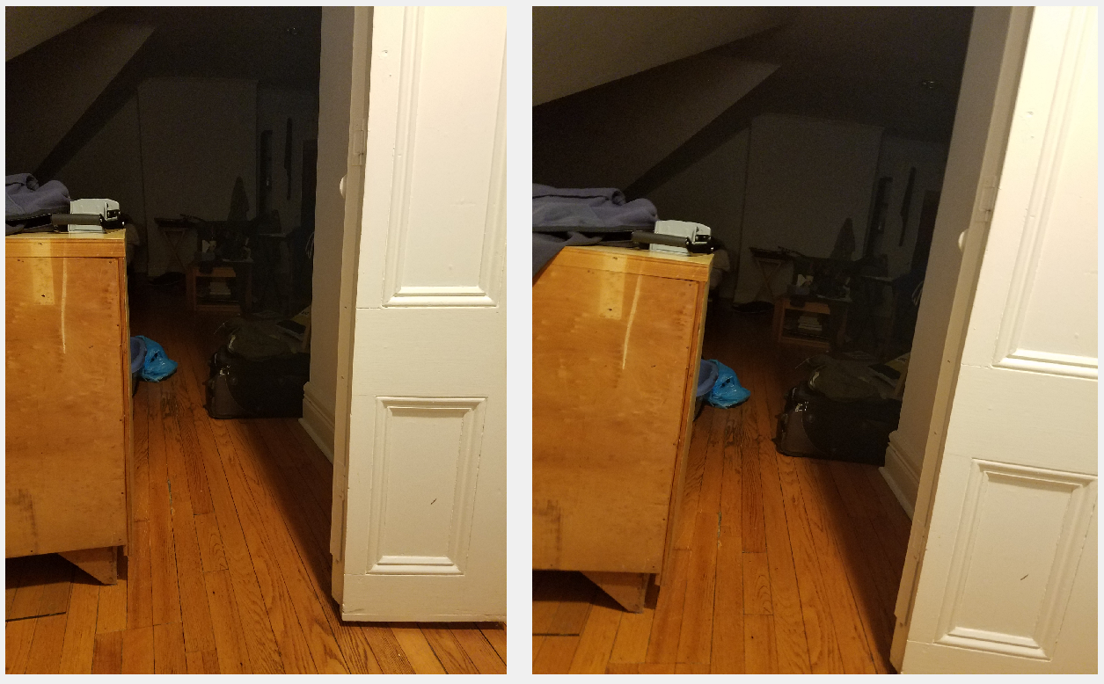
The scene: data acquisition

Slide 8
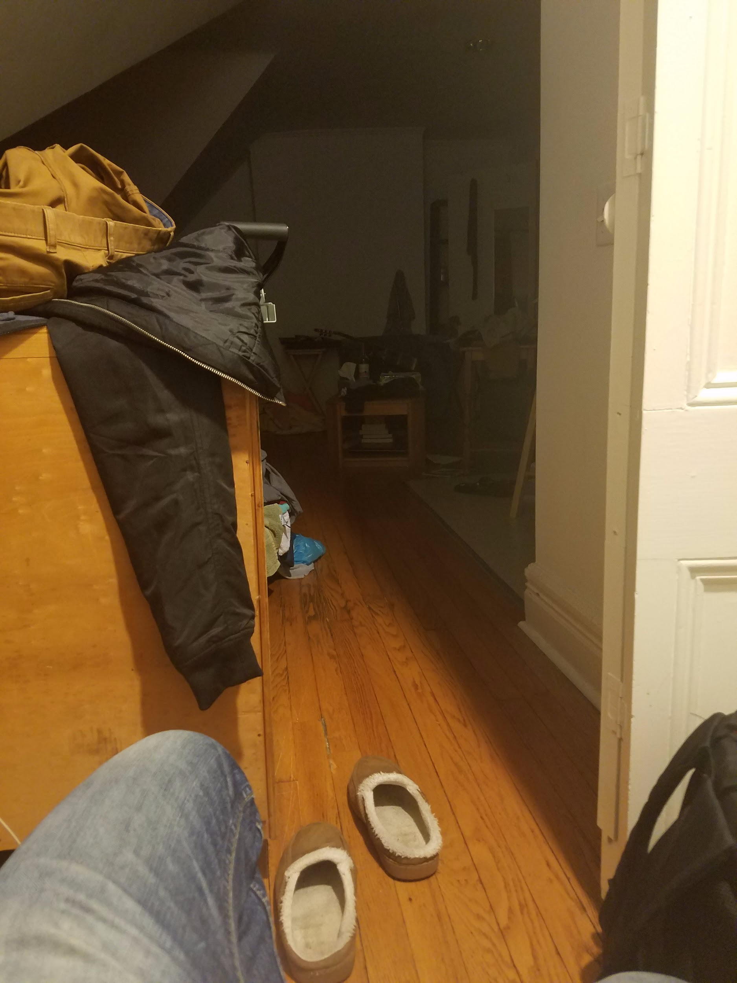

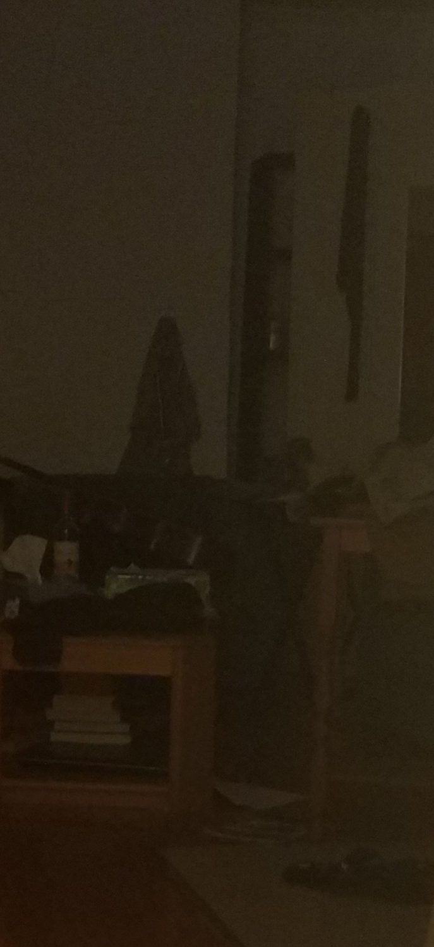
The Scene
...and 21 other very similar photos
Only interested in the high noise region:

Slide 9
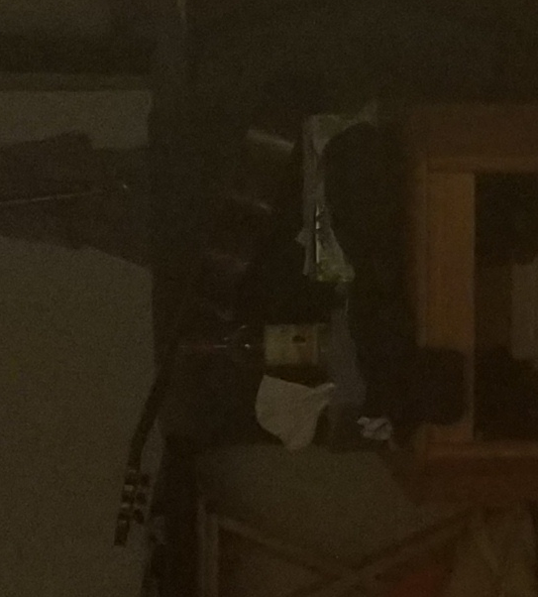
Detail of the noise in the Region of Interest

Slide 10
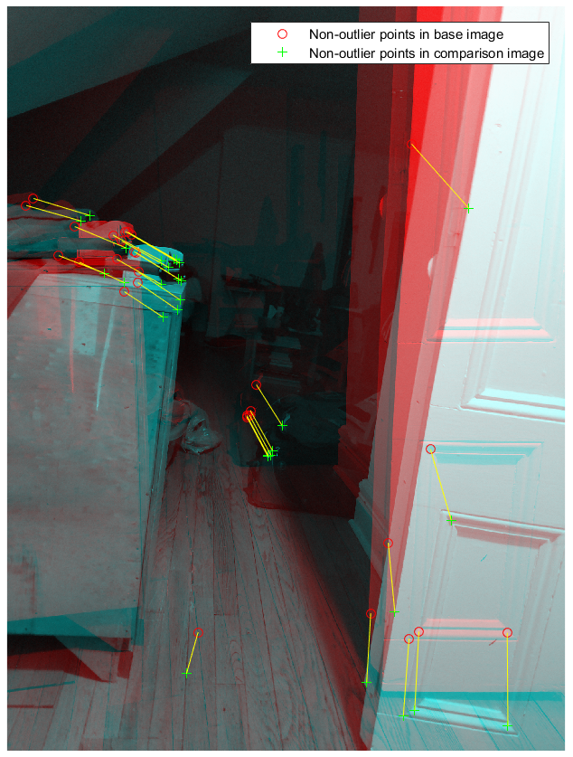
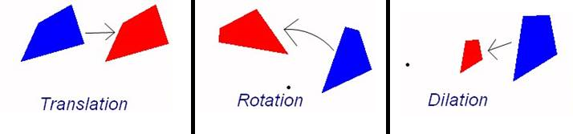
Image alignment
Uncalibrated Stereo Image Rectification function in matlab computer vision toolbox.
Find features and match them between images using the sum of absolute differences at the pixel locations.
Transform the image to a common reference plane (reference plane of the first image).

Slide 11
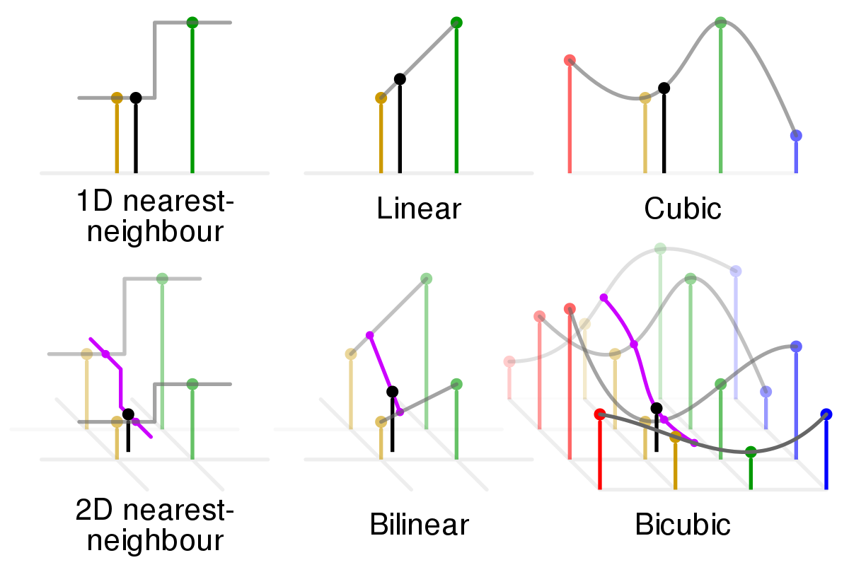
Interpolation
Increase resolution through bicubic interpolation.
Bicubic seemed best since bilinear blurs edges and 2D nearest neighbor looks blocky
Problem with bilinear: intensify noise and creates extremes.
Solution: Average through the multiple images to decrease noise and remove extremes

Slide 12
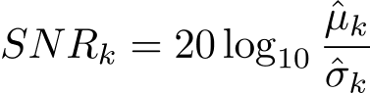
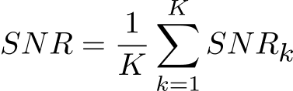
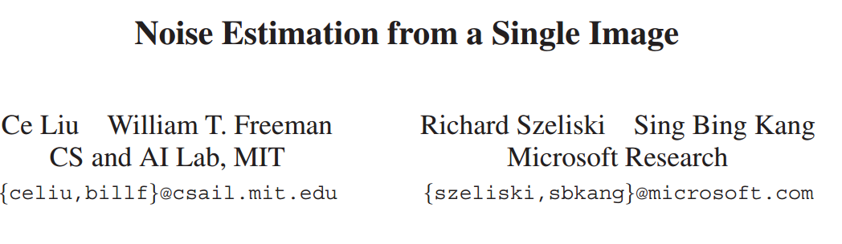
SNR Evaluation
Segment the image in K similar clusters using k-means algorithm.
Evaluate SNR in each cluster.
mean
standard deviation.
Average clusters’ SNR.

Slide 13
Results

Slide 14
Creating the superimages

Slide 15
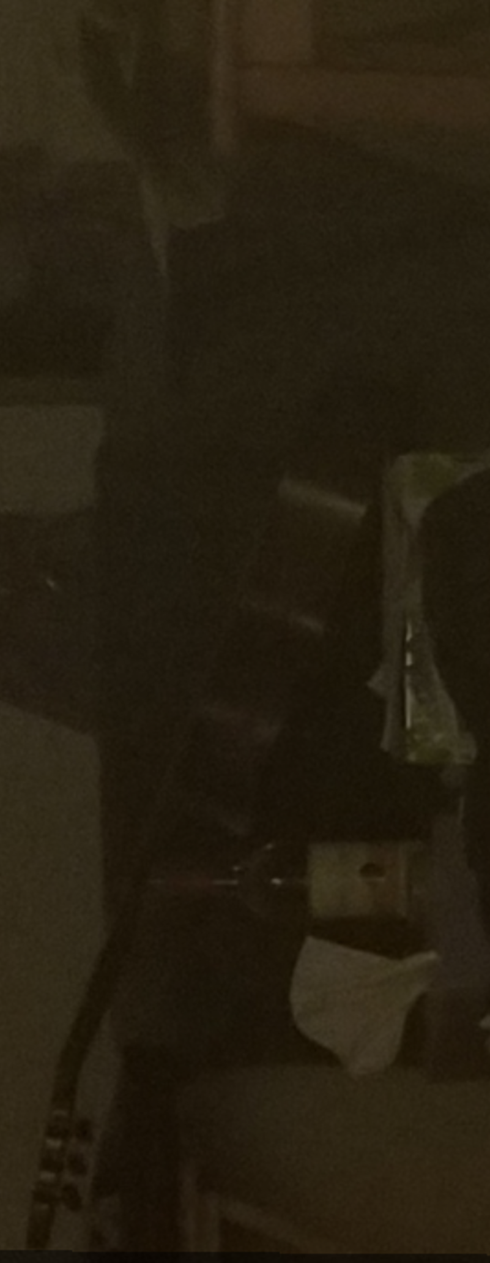
Creating the superimages: zooming + cropping

Slide 16
Creating the superimages: 1 image

Slide 17
2 images

Slide 18
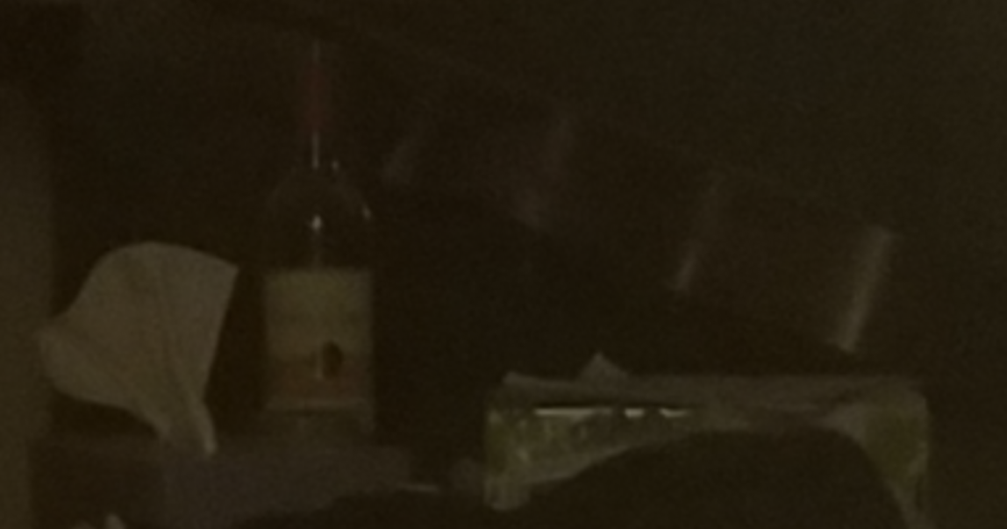
Creating the superimages:3 images

Slide 19
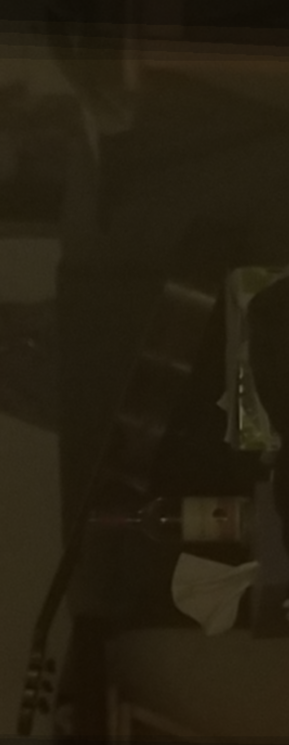
Creating the superimages… 7 images

Slide 20
Creating the superimages: 1 image vs 1 super resolution image created from 7 images, the most zoom

Slide 21
Creating the superimages: 1 image vs 1 super resolution image created from 7 images, the most zoom

Slide 22
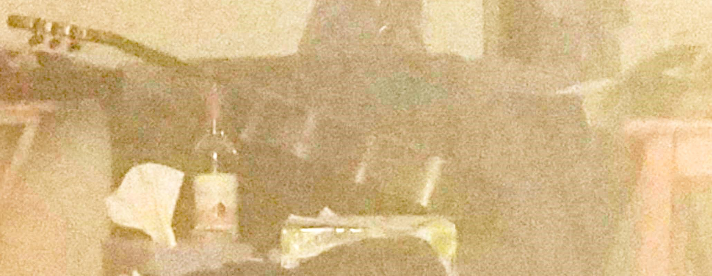
Why not just do an average on the original image?

Slide 23
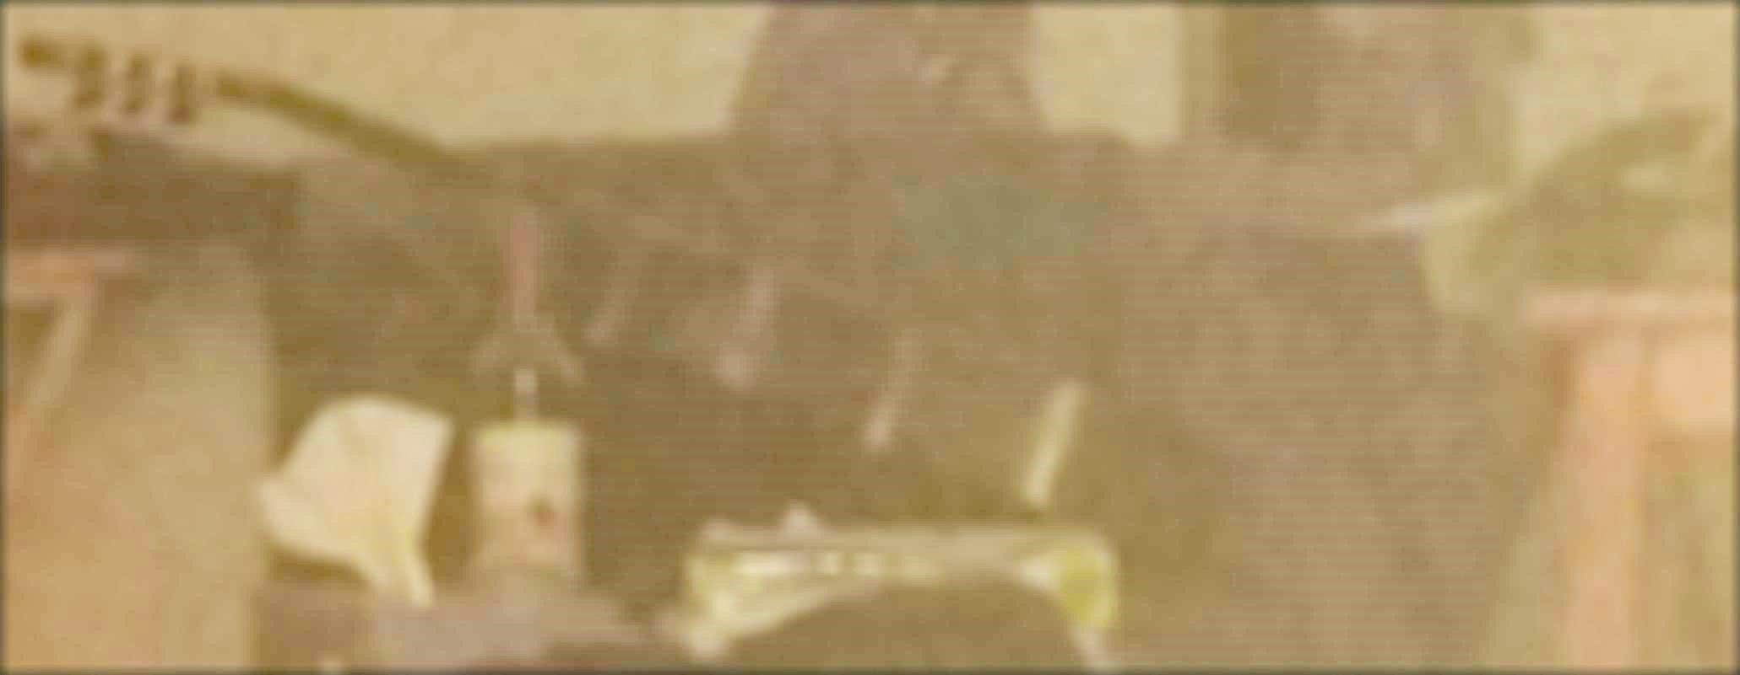
15x15 kernel mean-filtered original image

Slide 24
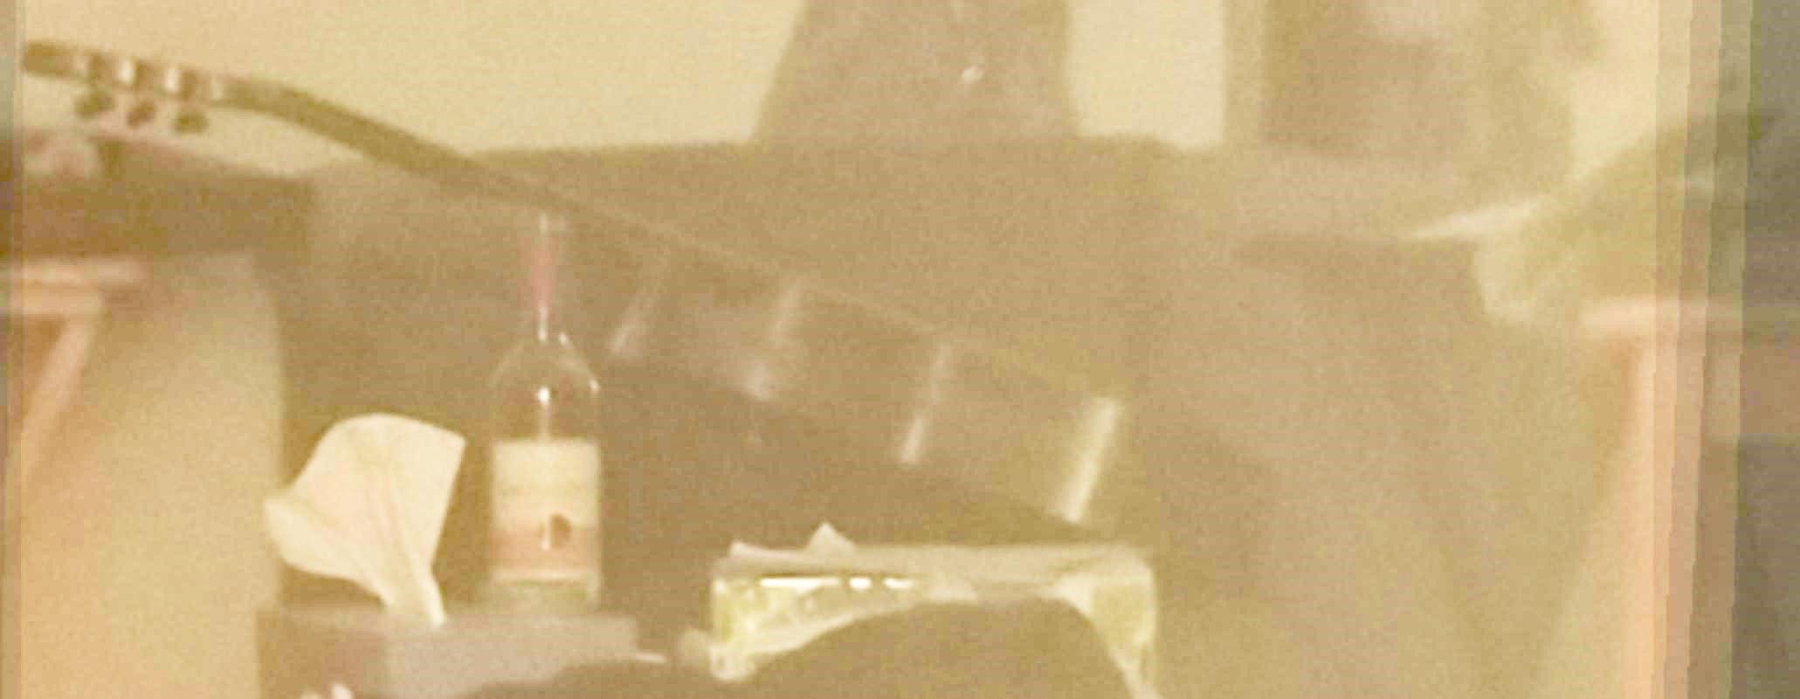
Superimage

Slide 25
The original, again

Slide 26
Why not just average the original image?
Super resolution image
Original
15x15 kernel mean-filter
Mean filter:
Remove noise.
Blurs image.
Loss of sharp edges.
Super resolution image:
Removes noise
Preserves sharp edges.

Slide 27
Noise analysis
3 ways:
SNR,
Single row of pixels,
Image gradient

Slide 28
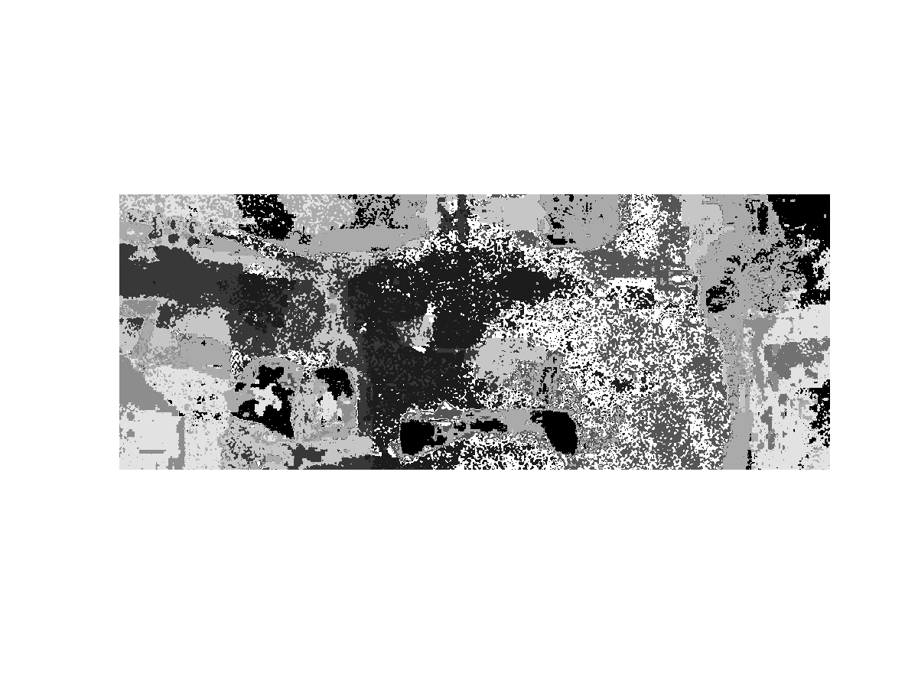
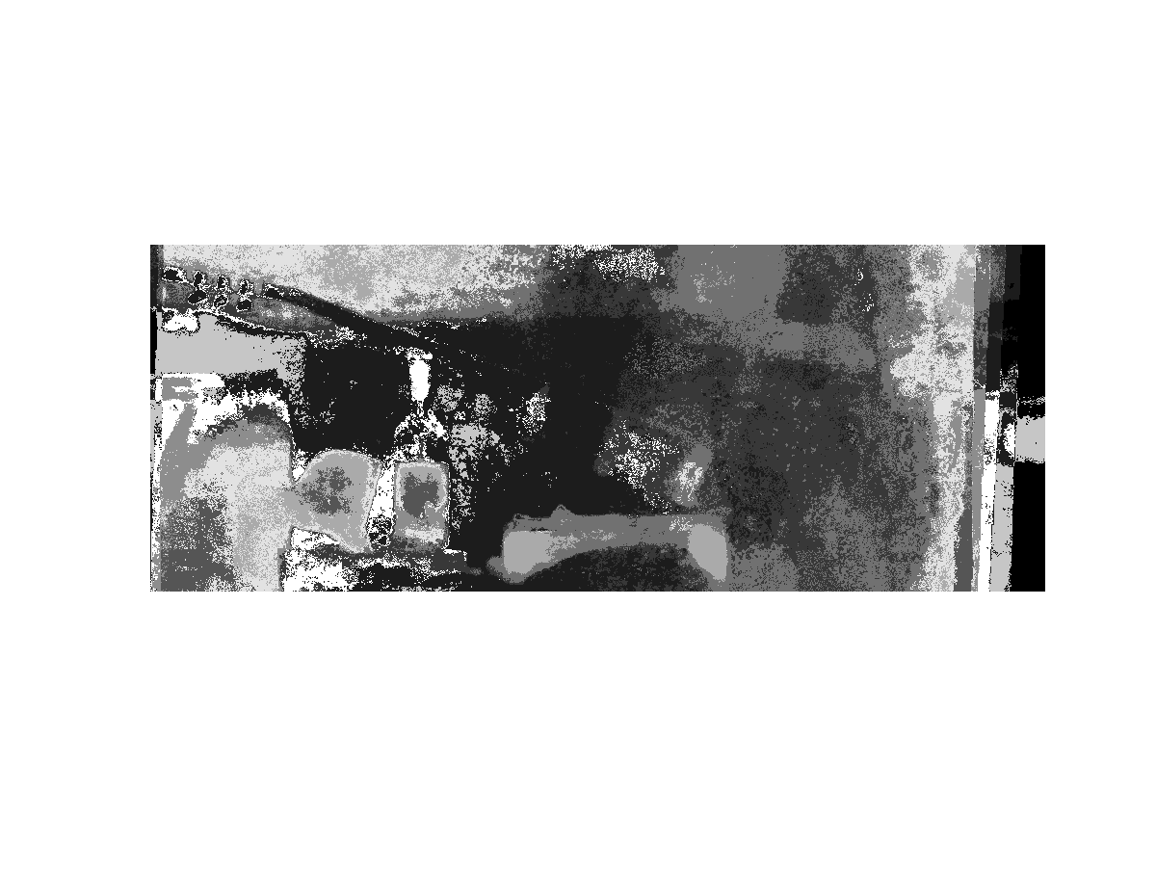
SNR Evaluation
K = 10.
SNR_{Intensity} increased by 1.5 dB
SNR_{Intensity} = 15.36 dB
SNR_{Red} = 18.67 dB
SNR_{Green} = 17.10 dB
SNR_{Blue} = 10.65 dB
Shaded by clusters
SNR_{Intensity} = 16.57 dB
SNR_{Red} = 20.21 dB
SNR_{Green} = 17.89 dB
SNR_{Blue} = 12.46 dB

Slide 29
Row of pixels
Take a 1d signal vector of this row of pixels and look at that

Slide 30
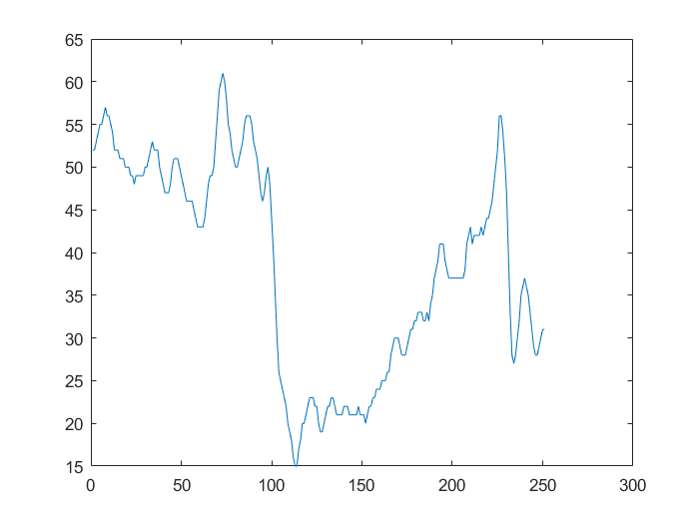
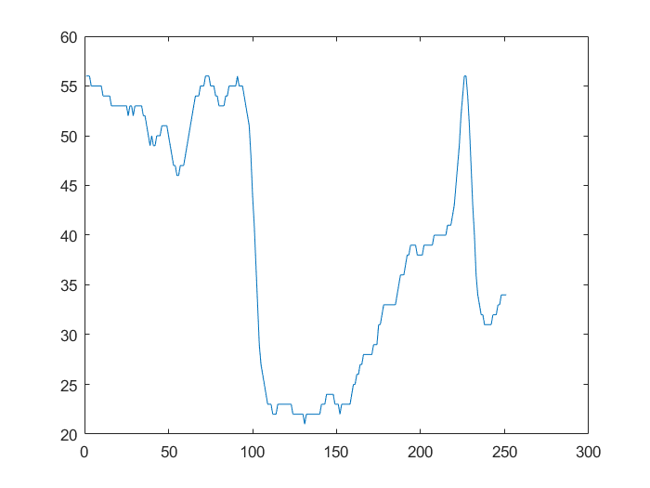
original
superimage
Higher numbers mean lighter color
Green chair
tissue
Bottle label
Superimage is a bit smoother, but the edges themselves are sharper. Bicubic interpolation gets evened out (if it were linear interp the edges would be more blurry)

Slide 31
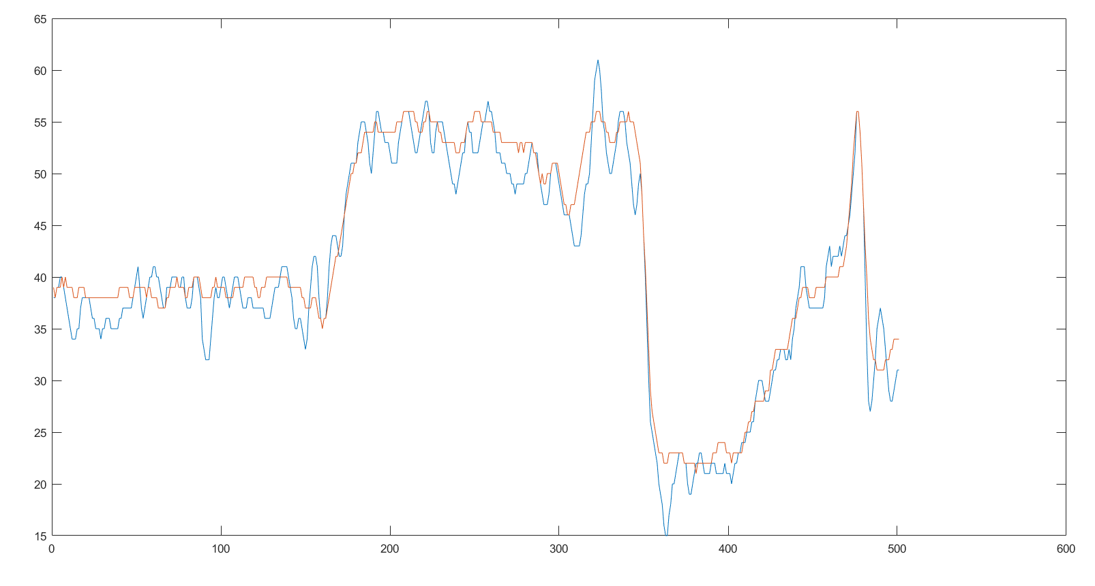
Green chair
tissue
Yellow wall
Bottle label
After super image transform, the signal is closer to the “ideal image” - piecewise continuous w/ sharp edges

Slide 32
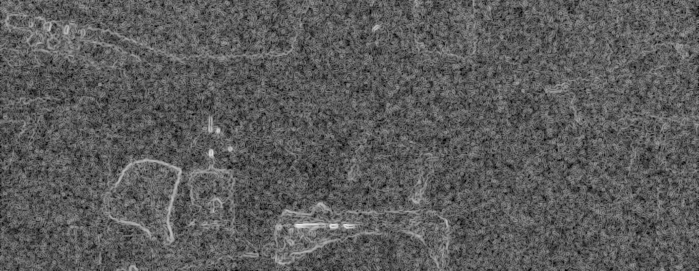
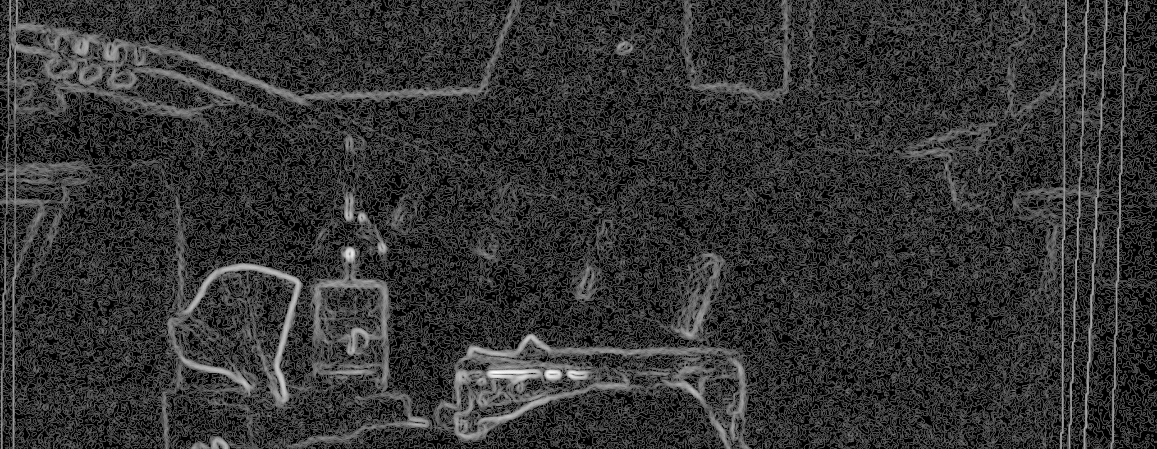
Edges: magnitude of image gradient shown here; the magnitude of the edge strength in the images
original
superimage

Slide 33
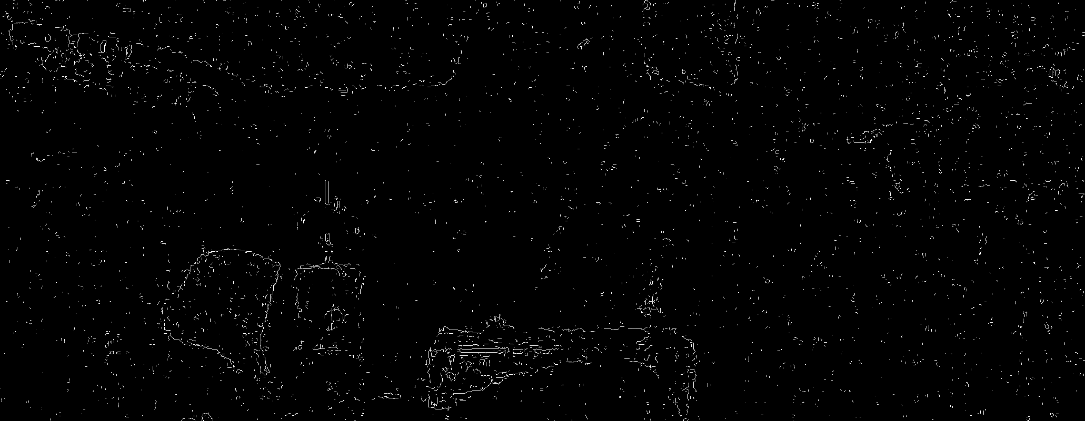
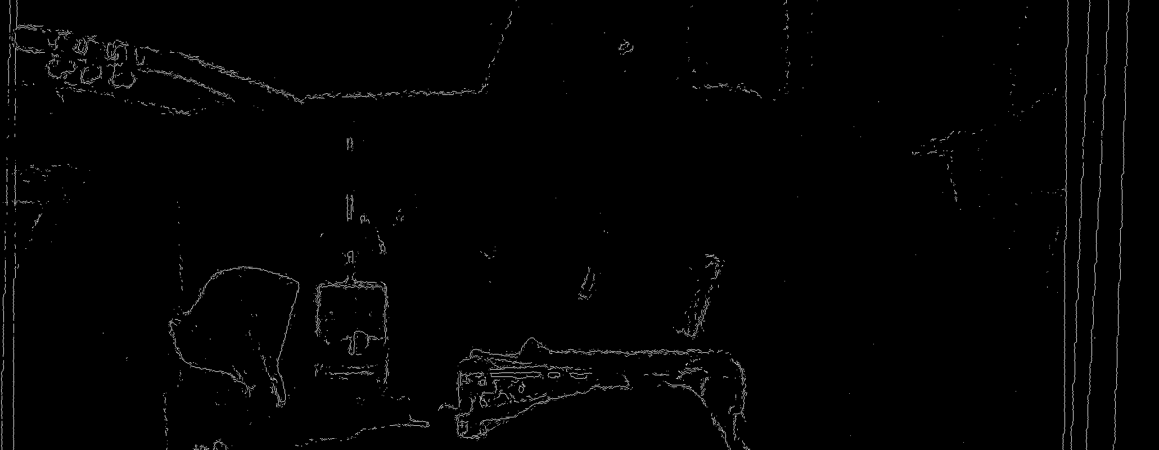
Thresholded edges
original
superimage

Slide 34
Conclusions
Super resolution imaging:
Increase resolution.
Increase details.
Increase SNR.
Preserves edges.
Increase sharpness.

